Slide 1
Integrate data from Notebooks with Azure Data Factory or Azure Synapse Pipelines
Notes:
Instructor notes and guidance.
In this module, explain to the students that they will learn how Azure Data Factory/Synapse Pipelines can orchestrate large scale data movement by using other Azure Data Platform and Machine Learning technologies. Stress to the students that this enables them to take advantage of the capabilities of other Azure Data Platforms to manipulate data rather than using the built-in capabilities of Azure Data Factory/Azure Synapse Pipelines (ADF/ASP) including the copy activity and the mapping data flow covered in the previous modules.
The reason for taking this approach is varied. Some organization may already have data engineering investments in other technologies that they would like to take advantage of. It could be that Azure Data Factory/Azure Synapse Pipelines does not have the capabilities that are required within the pipeline. At a simple level, you may have a team of data engineers that simply have a preference for using a specific technology. Regardless of the reason, this module explores how you can take advantage of Azure Data Factory/Azure Synapse Pipelines to orchestrate the pipeline that involves other Data Platform technologies. As a result, you need to be familiar with the Azure Data Factory/Azure Synapse Pipelines Control Flow component and how parameters can be used within them.
Share with the students that Azure Data Factory/Azure Synapse Pipelines can work with a wide variety of data platform technologies from Azure Machine Learning through to Azure Functions. In this module and the associate lab, share that you will explore how we can orchestrate notebooks as that is a common tool used by data engineering.

Slide 2
Agenda
Perform code-free transformations with Azure Data Factory or Azure Synapse Pipelines
Integrate data from Notebooks with Azure Data Factory or Azure Synapse Pipelines
Notes:
TALKING POINTS
Let’s set an agenda for today’s presentation in which we are going to discuss the following:
Integrate data from Notebooks with Azure Data Factory or Azure Synapse Pipelines
PRESENTER NOTES AND GUIDANCE
Don’t take too much time in order to present the agenda. Make the points in the topics.

Slide 3
Perform code-free transformations at scale with Azure Synapse Pipelines
1

Slide 4
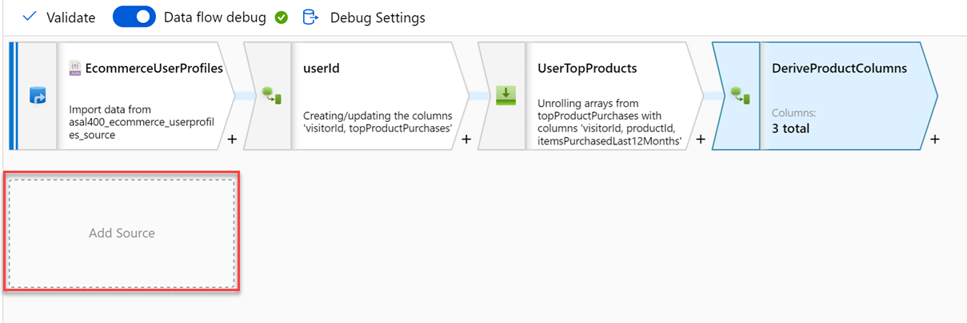
Code-free transformation at scale with Azure Data Factory or Azure Synapse Pipelines
Notes:
Talking points
Let’s dive into the data flow mapping
Mapping data flows are visually designed data transformations in Azure Data Factory or Azure Synapse Pipelines.
Data flows allow data engineers to develop graphical data transformation logic without writing code.
The resulting data flows are executed as activities within Azure Data Factory/Synapse pipelines that use scaled-out Spark clusters.
Data flow activities can be operationalized via existing Data Factory/Synapse Pipeline scheduling, control, flow, and monitoring capabilities. Mapping data flows provide a fully visual experience with no coding required.
Your data flows will run on your own execution cluster for scaled-out data processing. Azure Data Factory/Synapse handles all the code translation, path optimization, and execution of your data flow jobs.
Data Flow mapping brings the following benefits and capabilities:
- Perform data cleansing, transformation, aggregations, etc.
- Enables you to build resilient data flows in a code free environment
- Enable you to focus on building business logic and data transformation
- The underlying infrastructure is provisioned automatically with cloud scale via Spark execution
Like many data transformation tools, Mapping Data Flow in Azure Data factory supports a great variety of data transformations.
Instructor notes and guidance.
Note that this content is valid for both Azure Data Factory and Azure Synapse Pipelines. Consider showing an example through a demo, you should consider replaying some of the activities done in the lab. The feedback from MCTs about DP200 is that many students needed help the ADF lab, so replaying the mapping data flow should be considered.
Recommended reading for this slide
Code-free transformation at scale with Azure Data Factory - Learn | Microsoft Docs

Slide 5
Integrate data from Notebooks with Azure Data Factory or Azure Synapse Pipelines
2
Notes:
TALKING POINTS
Let’s go over integration data from Notebooks with Azure Data Factory or Azure Synapse Pipelines.
PRESENTER NOTES AND GUIDANCE
N/A.

Slide 6
Integrate data from Notebooks with ADF or Synapse Pipelines
1.
Use Storage
Account
2.
Use Azure
Synapse Pipeline
3.
Create a
pipeline
4.
Add a Notebook
Activity to the
pipeline
5.
Set parameters
& dependency
conditions
Notes:
Talking points
The attendees should already be familiar with the first three steps of creating a storage account, creating Azure Data Factory/Synapse Pipelines, and creating a data workflow activity using a Copy Activity.
Focus on steps 4 and 5 which are focused on Azure Synapse Analytics Spark pools.
Instructor notes and guidance.
Call out to the students that step 4 can involve other technologies such as Azure Databricks notebooks.
Recommended reading for this slide
Orchestrating data movement and transformation in Azure Data Factory - Learn | Microsoft Docs

Slide 7
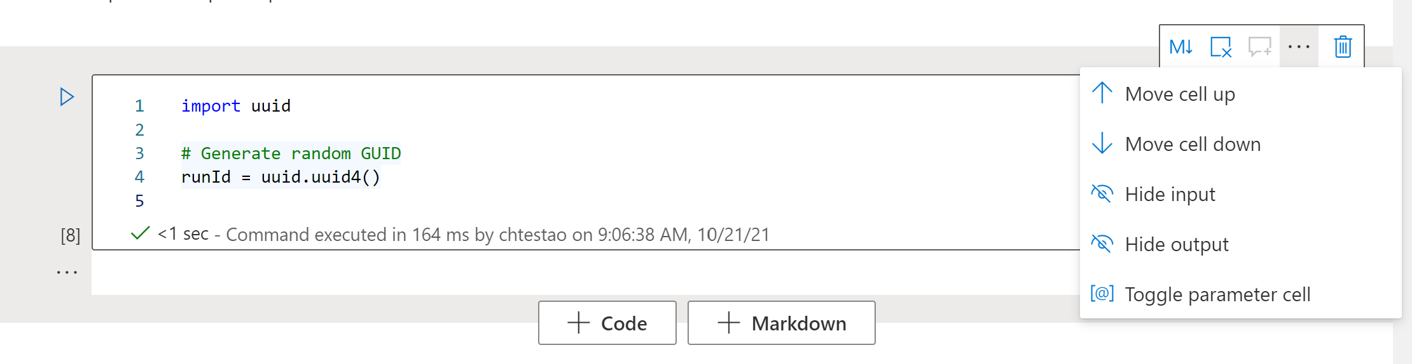
Toggling a notebook cell to use parameters
The cell’s context menu allows you to toggle it between being a normal code cell and a parameter cell

Slide 8
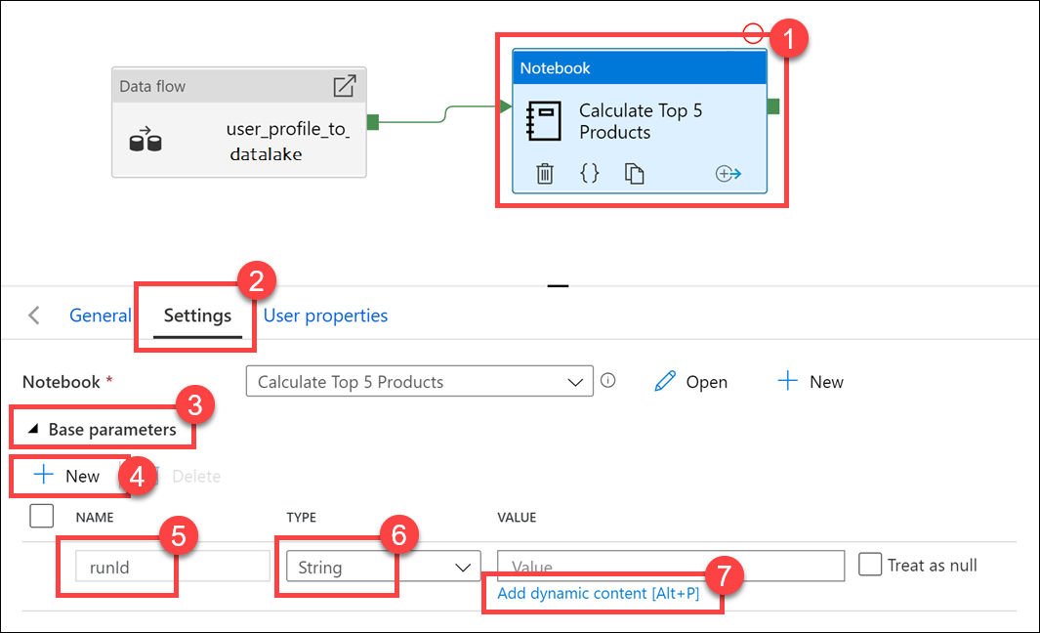
The Synapse pipeline notebook activity can send parameters to the notebook.
Notice the name of runId matches the name of the parameter variable used in the parameter cell.

Slide 9
LAB 7: Integrate data from Notebooks with Azure Data Factory or Azure Synapse Pipelines
60 minutes
Notes:
TALKING POINTS​
​
Let’s put this into reality and show you how it works.​
​In the lab, the students will create a notebook to query user activity and purchases that they have been made in the past 12 months. They will then add the notebook to a pipeline using the new Notebook activity and execute this notebook after the Mapping Data Flow as part of their orchestration process. While configuring this, the students will implement parameters to add dynamic content in the control flow and validate how the parameters can be used.
In exercise 1 of this lab, the students will create a notebook, and there is an argument that this exercise is not relevant to the objective of the module which would be a fair comment. As a development team, we decided to keep this exercise on the basis that we received overwhelming feedback from MCTs that they wanted the course to have each module independent from each other. As a result, exercise 1 has been retained so that you can teach this module in isolation so that the students understand exactly what the notebook is doing, and how the parameter in the notebook will be used in exercise 2. Furthermore, it has removed a dependency on teaching Module 5 and 6 should you wish to tailor the course.
By creating the notebook in exercise 1, they then manage the orchestration of this notebook in an existing pipeline in exercise 2. This allows students to experience working with control flow, managing the flow and working with parameter to add dynamic capabilities to the pipelines that are built. The students will then execute the pipeline that they have modified with this orchestration to view the impact of the work that they create. It’s important to reinforce to the students the regular use of parameters in enterprise grade ETL solutions.

